Slide 1
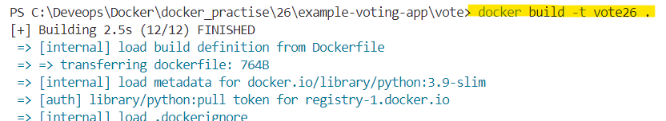

Vote app: To build the vote app docker image , from the docker file in vote folder.

Slide 2
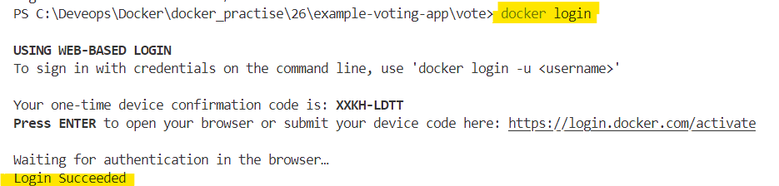
Docker Hub login

Slide 3
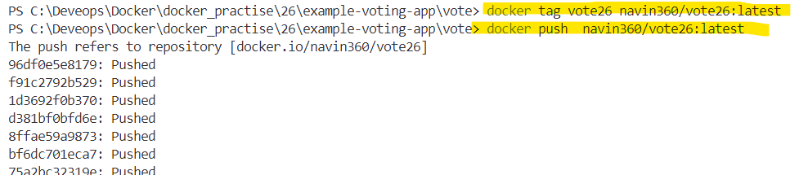
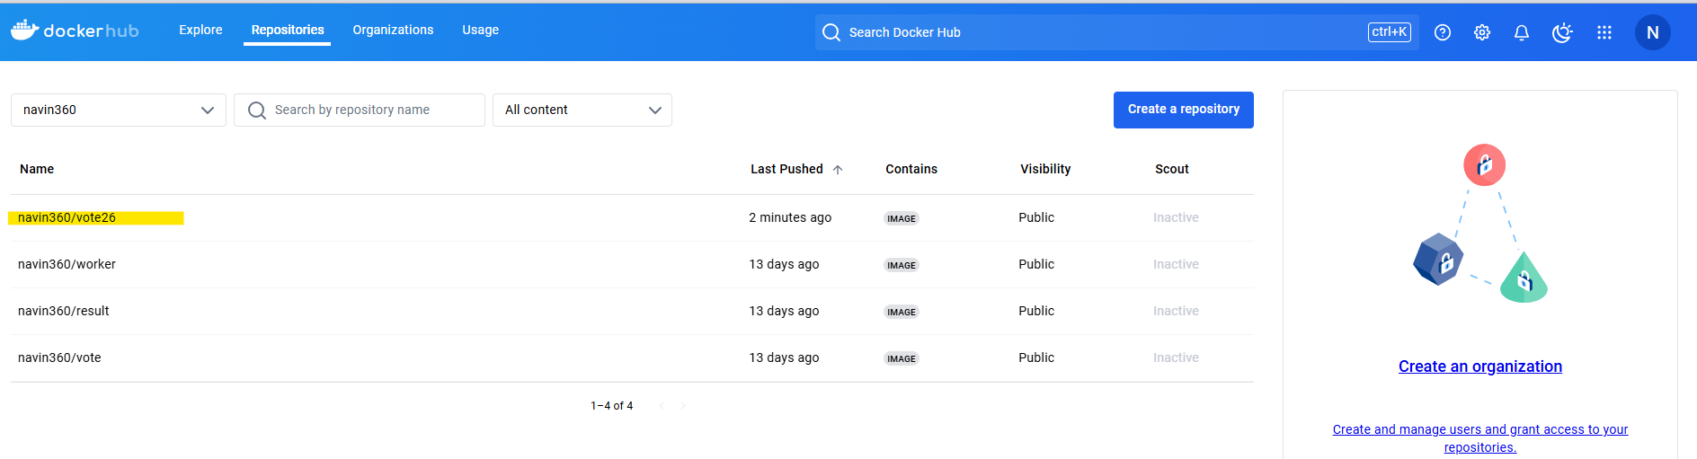
Vote app: Docker tag and pushing to the docker hub

Slide 4
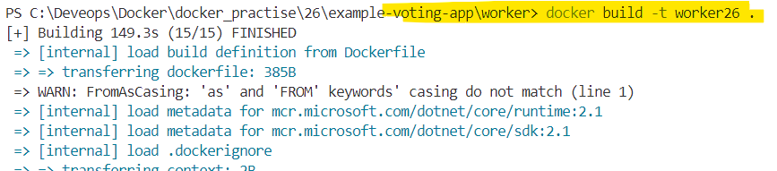
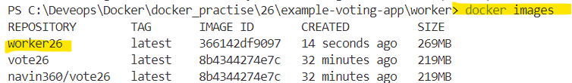
worker app: To build the worker app docker image , from the docker file in vote folder.

Slide 5
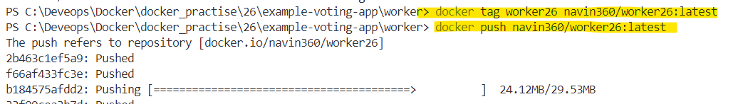
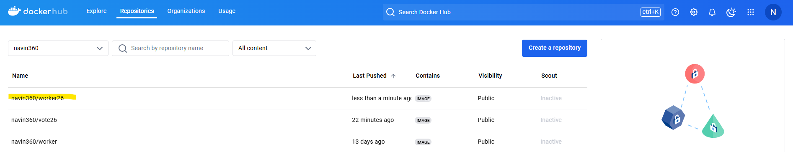
worker app: To push the docker image to docker hub.

Slide 6
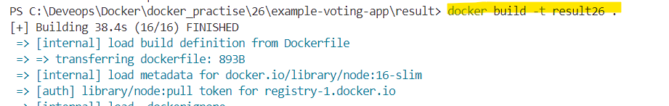
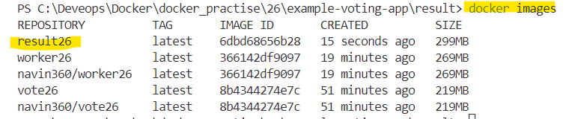
Result app : To build the docker image

Slide 7
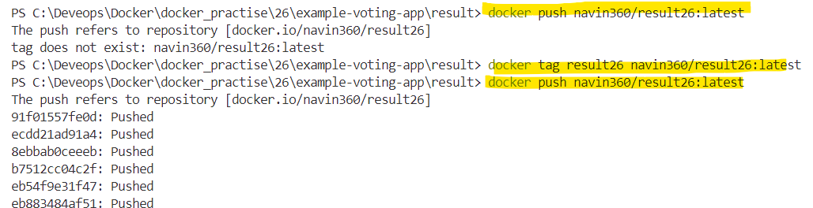
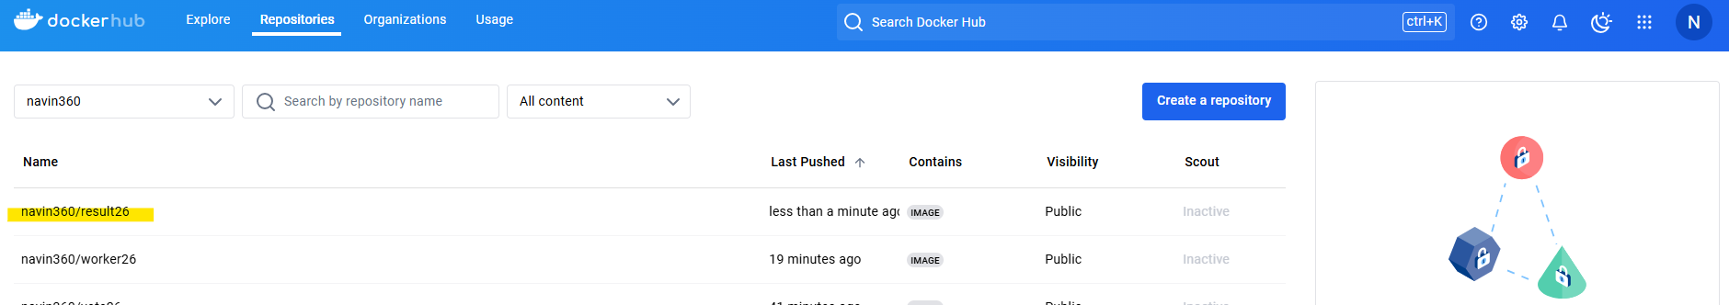
Result app : To push the docker image

Slide 8
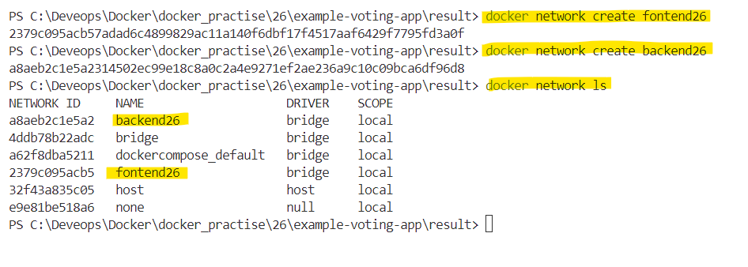
Create network frontend and backend.

Slide 9
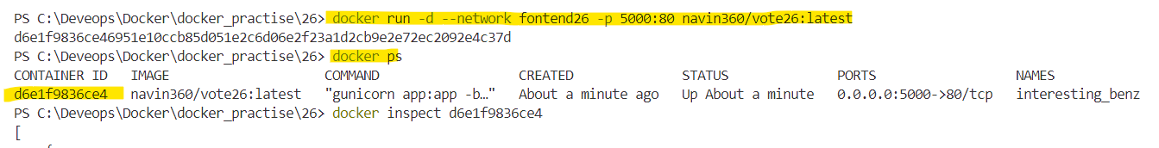
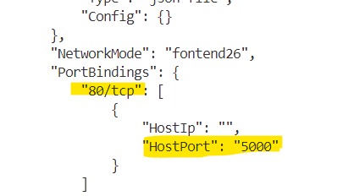
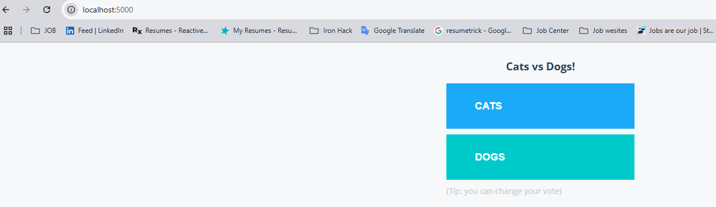
Create a container form the voting app image and connect it to the frontend network. The exposed port for voting app is 5000. Verify this by inspecting docker image or check the exposed port in Dockerfile.
Host port : 5000
Container port : 80

Slide 10
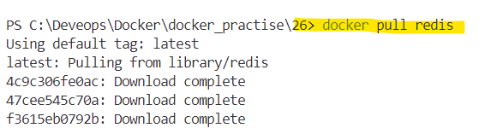

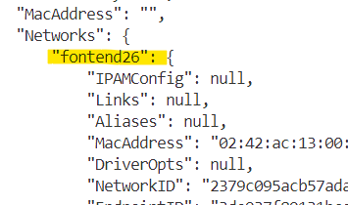
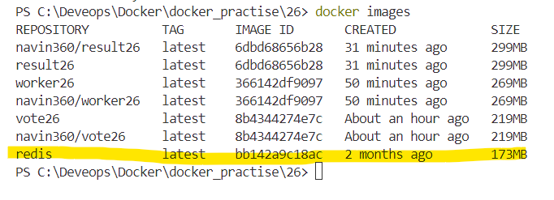
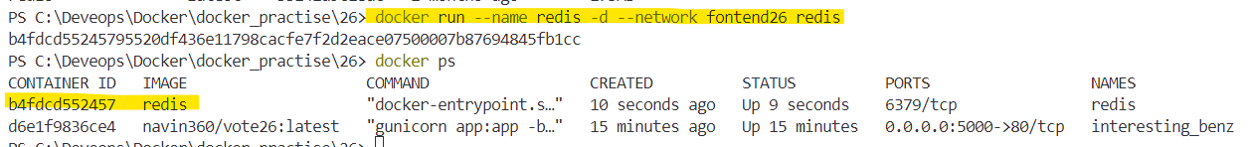
Create another container from the redis latest image. Name the redis container as redis. The voting app communicates with the redis database with this name. Also, connect this container with frontend network.

Slide 11
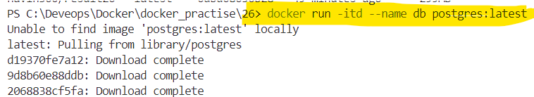
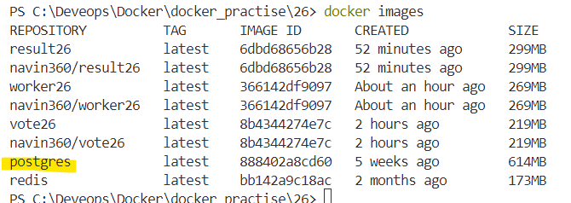
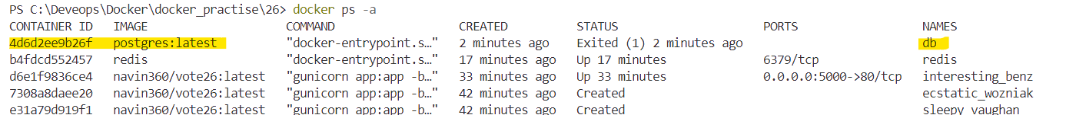
create another container from the postgres latest image. Name the database as db.

Slide 12
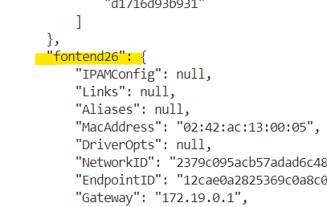
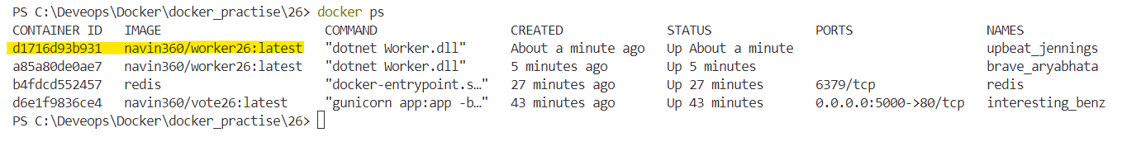
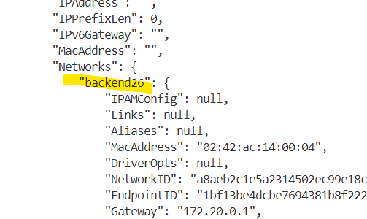
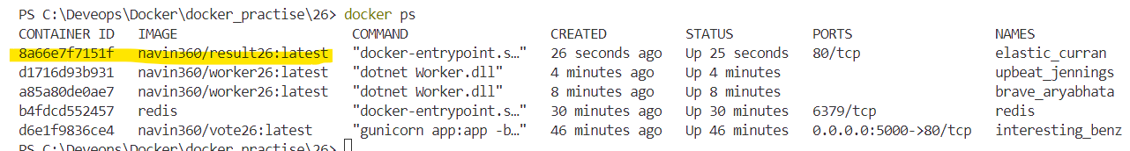
Create another container from the worker image created in step 4. Connect this container to both frontend and backend network
Create another container from the result app image created in step 3. Connect this container to the backend network.

Slide 13
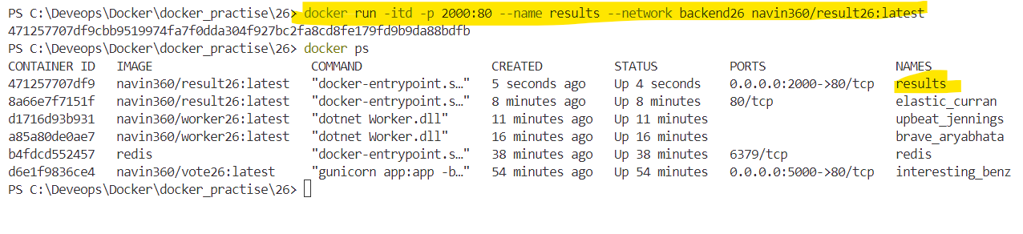
Create another container from the result app image created in step 3. Connect this container to the backend network. And assign it to port 2000

Slide 14
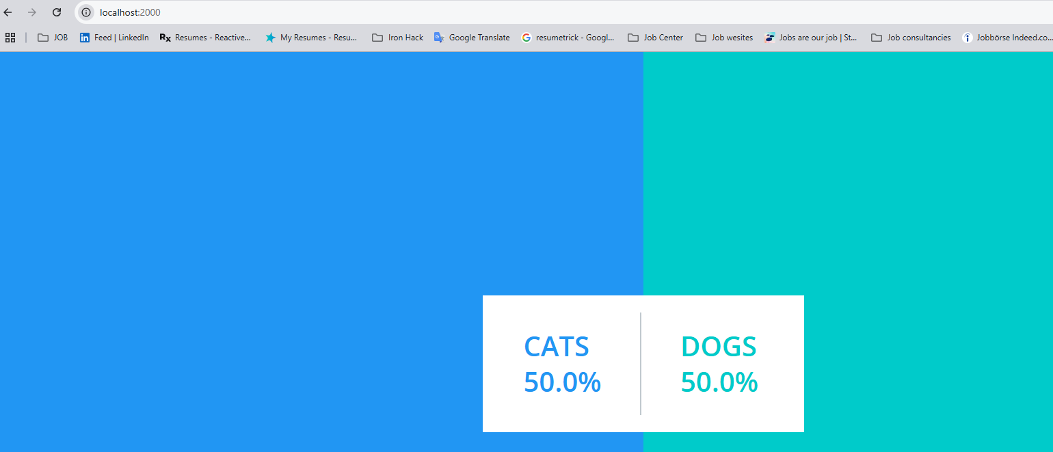
Launch the voting and result applications in different browsers.
Upon selecting one of the options on the voting app, it should result in the votes update on the result app. This verifies the working of microservices

